Slide 1
Urban Sound Classifier
ECEN 4/5632, P. Mathys

Slide 2
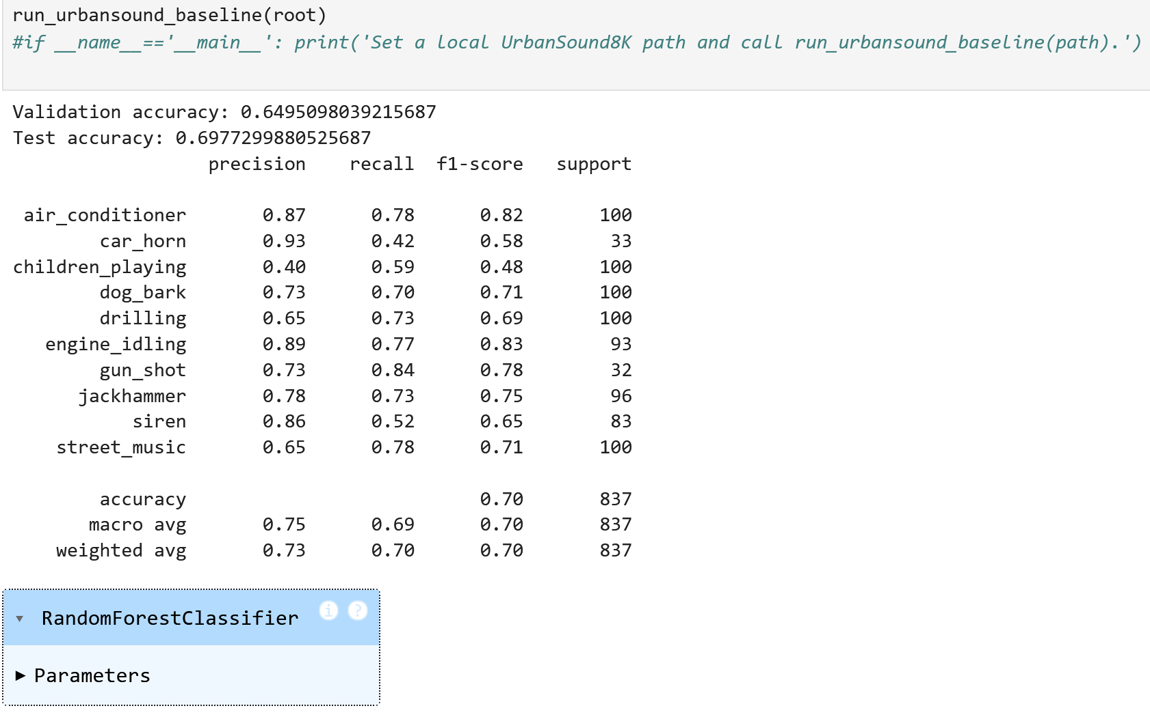
Random Forest, First Run

Slide 3
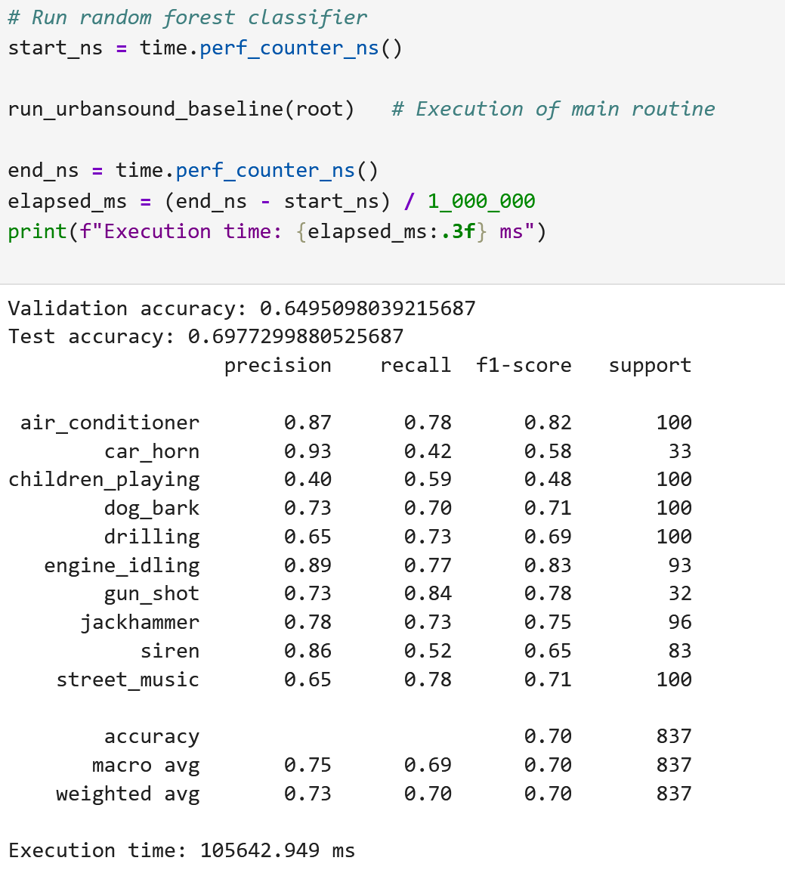
Random Forest, Second Run

Slide 4
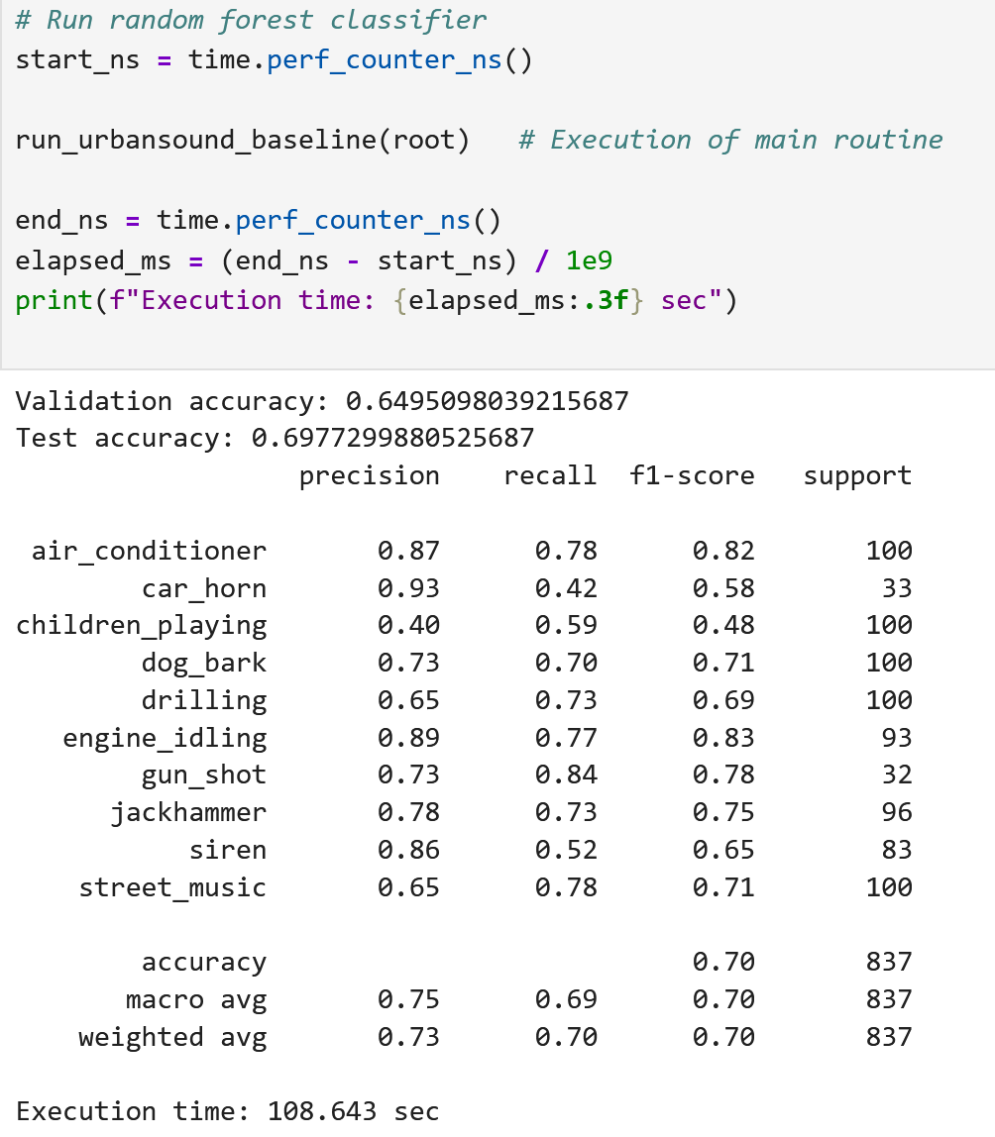
Random Forest Third Run

Slide 5
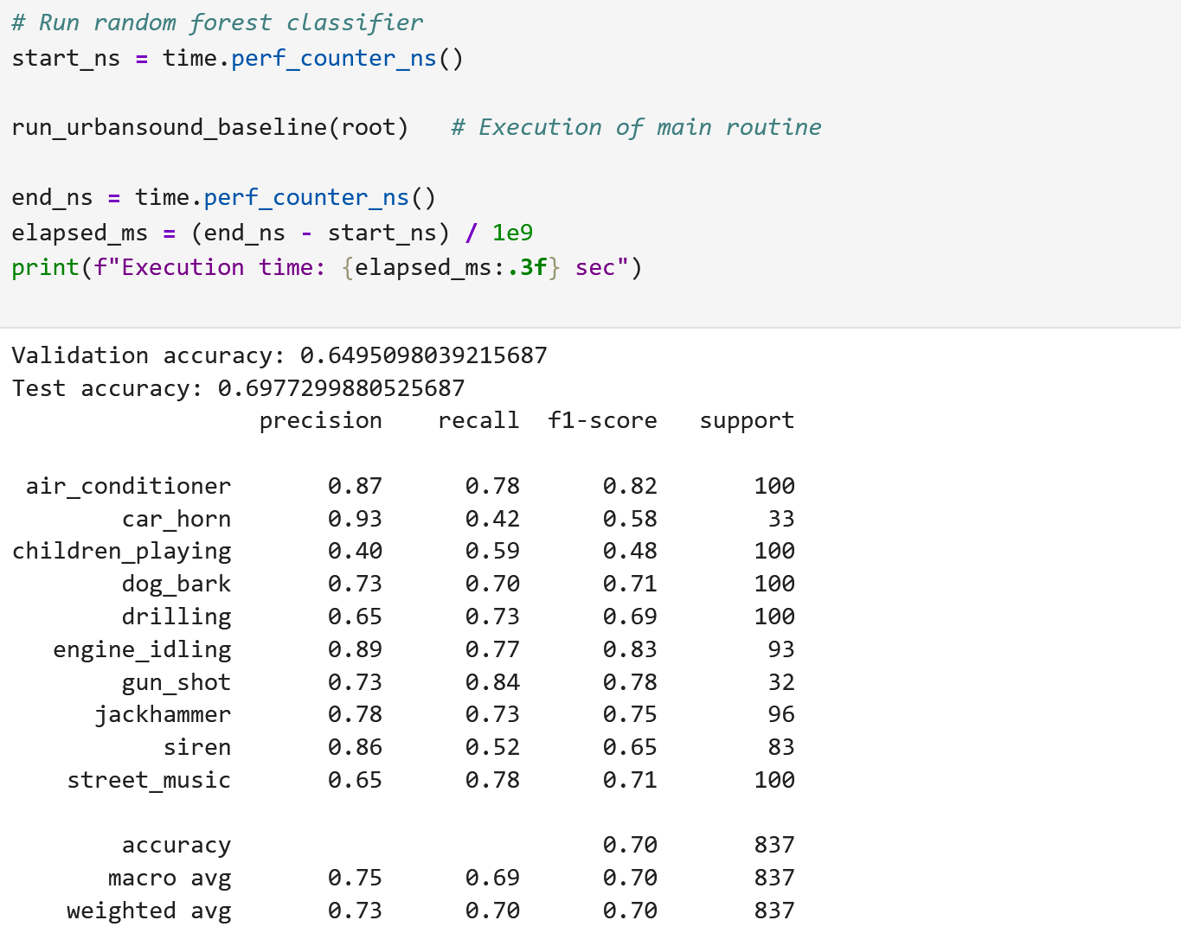
Random Forest Fourth Run

Slide 6
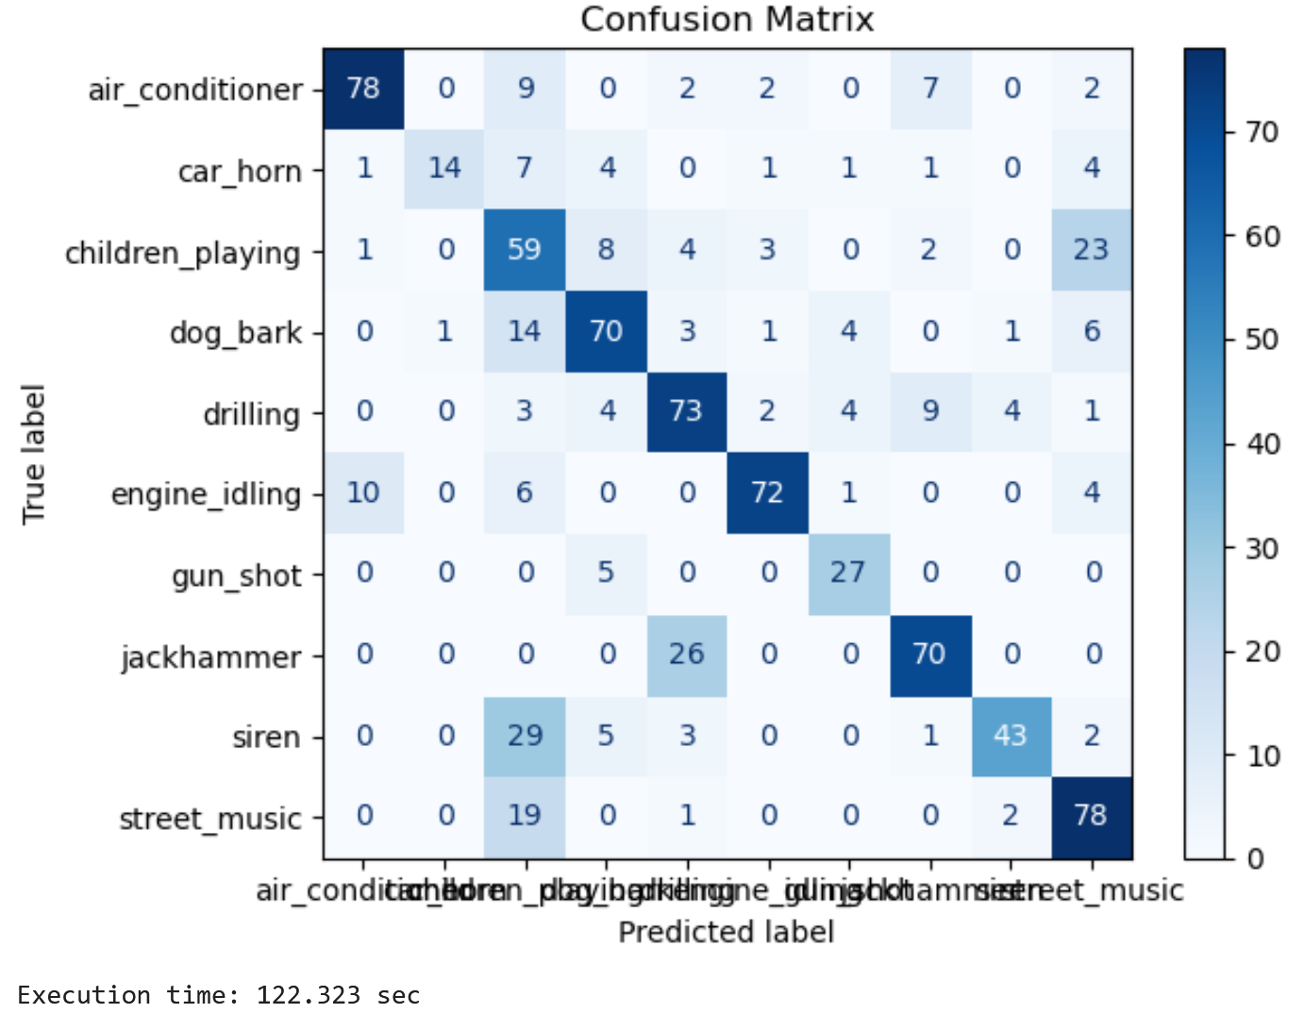
Random Forest Fourth Run

